Slide 1






VENTRADE TECHNOLOGY
RANSOMWARE DEFENSE COMMAND CENTER
Full-scenario incident response and resilience services for Malaysia
WHEN RANSOMWARE STRIKES, MINUTES DECIDE LOSSES.
VENTRADE delivers prevention, assessment, monitoring, response, recovery, drills and education through a battle-tested cross-border expert bench.
400+
4 h
24 h
48 h
INCIDENTS HANDLED
REMOTE SLA
EXPERTS ON SITE
ACTIONABLE REPORT
RESPOND
ASSESS
RECOVER
EVIDENCE
TRAIN
01

Slide 2



VENTRADE TECHNOLOGY
MALAYSIA RANSOMWARE PRESSURE
Demand is rising faster than local deep-response supply
MAHB
+153%
US$10M ransom demand
reported ransomware cases in 2024 vs. 2023
Manufacturing
12,643
Qilin, INC Ransom, Crypto24
AirAsia
4,982
about 5M records exposed
2023
2024
Regulatory pressure now makes evidence-ready response a board issue.
NACSA
PDPA
BNM RMIT
DOWNTIME
02

Slide 3
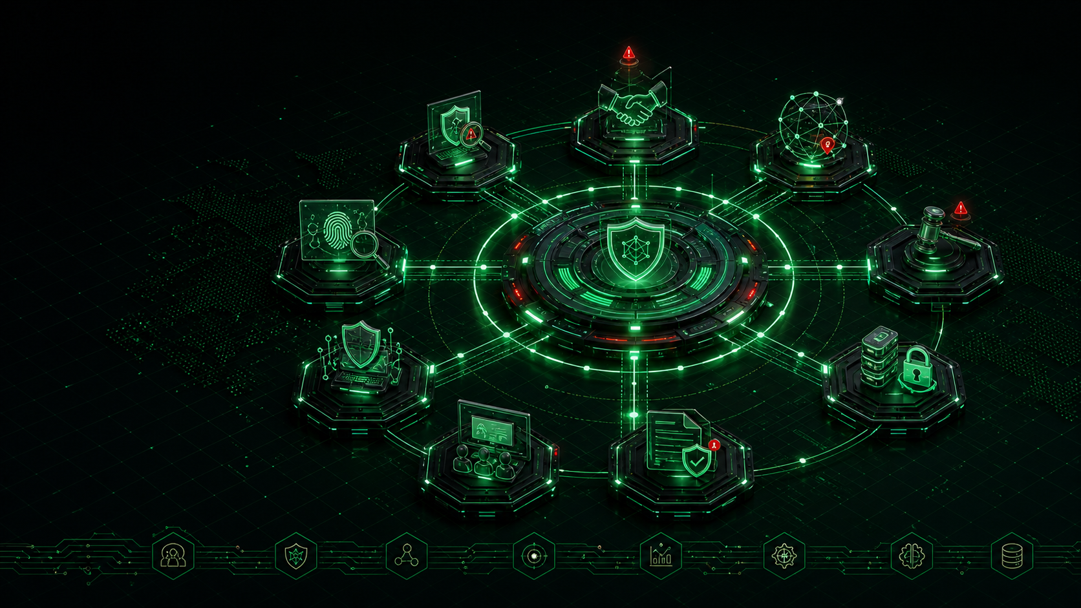
VENTRADE TECHNOLOGY
VENTRADE OWNS THE RESPONSE GAP
Positioned above commodity SPA and licensed SOC monitoring
1
SPA / VAPT
2
MANAGED SOC
3
DEEP RANSOMWARE RESPONSE
COMMODITY
LICENSED RED OCEAN
VENTRADE SPECIALIST LAYER
Point-in-time reports
NACSA licence scope
Negotiation support
Price-driven market
Detects and alerts
Dark-web monitoring
Many local providers
Crowded 24/7 market
Encrypted-data recovery
NACSA licence note: monitoring and penetration testing are partner scopes; incident response, negotiation, dark-web monitoring, drills and training can be delivered directly.
ASSESS
MONITOR
RESPOND
RECOVER
03

Slide 4



VENTRADE TECHNOLOGY
EIGHT PILLARS, ONE RESILIENCE LOOP
A full service system from emergency recovery to staff awareness
Respond
Remediate
Defend
Simulate
Assess
Educate
Data
Collaborate
EMERGENCY RECOVERY
PROTECTION
EVALUATION
TRAINING
04

Slide 5
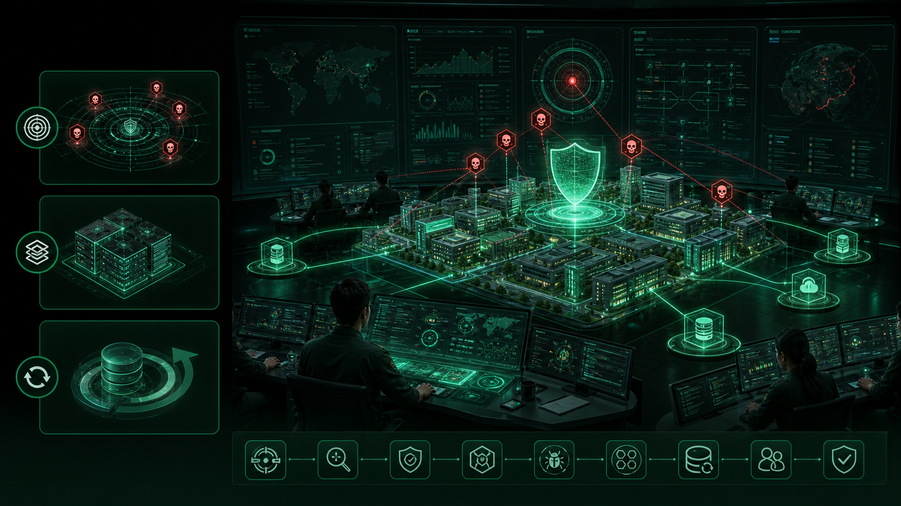

VENTRADE TECHNOLOGY
INCIDENT RESPONSE LIFECYCLE
One owner from confirmation to eviction
01
IDENTIFY & BLOCK
04
MONITOR EXPOSURE
Attribute crew and stop spread
Leak sites and public exposure
02
ASSESS LOSS
05
HARDEN
Scope damage and recovery path
Prevent secondary extortion
03
RECOVER DATA
06
TRACE & EVICT
Restore by business priority
Remove attacker access
END-TO-END RESPONSE
NEGOTIATION
EVIDENCE
RECOVERY
HARDENING
05

Slide 6
VENTRADE TECHNOLOGY
48-HOUR EMERGENCY PRE-PROCESSING
Three parallel tracks create management-ready answers
01
T+0 CONFIRM
04
TRACE
Attack verified and team mobilized
Intrusion path and group ID
02
CONTAIN
05
REPORT
Malware analysis and rapid hardening
Regulatory package prepared
03
ASSESS
06
DELIVER
Data-loss scope and recovery testing
Actionable pre-processing report
48H WAR ROOM
T+0
T+24H
T+48H
06

Slide 7

VENTRADE TECHNOLOGY
BATTLE-TESTED RESPONSE BENCH
Experience usually available only from overseas specialists
01
400+ INCIDENTS
04
4H INTERVENTION
Handled end to end
24/7 standby
02
SOE & ENTERPRISE
05
RANSOMWARE CREWS
On-site response experience
LockBit, BlackCat, Medusa
03
REGULATORY FILING
06
DATA RECOVERY
Report writing and evidence chain
Encrypted-data recovery support
EXPERT TEAM
LOCKBIT
ALPHV
MEDUSA
RAAS
07

Slide 8

VENTRADE TECHNOLOGY
THREE DEFENSE LAYERS
Defense depth maps to enterprise maturity and budget
01
LEVEL I
04
EMAIL GATEWAY
Block entries and reduce loss
Phishing and payload blocking
02
LEVEL II
05
BACKUP & AUDIT
Stop lateral movement
Recover and verify
03
LEVEL III
06
ZERO TRUST
Counter APT-level ransomware
Access and persistence defense
PROTECTION STACK
DETECT
DEFEND
RESIST
COUNTER
08

Slide 9
VENTRADE TECHNOLOGY
RISK ASSESSMENT ESTATE MAP
Three exposure zones and ten inspection domains
01
CORE DATA CENTERS
04
PRIVILEGED ACCOUNTS
Crown-jewel defense validation
Access concentration risk
02
OFFICE ENVIRONMENT
05
ATTACK SURFACE
Employee-side attack paths
Internet exposure and services
03
SUPPLY CHAIN
06
LOG & BACKUP
Vendor and partner entrances
Evidence and recovery readiness
RISK MAP
CORE
OFFICE
SUPPLY CHAIN
09

Slide 10

VENTRADE TECHNOLOGY
DATA COMPLIANCE BRAIN
Classify, grade and govern data before disclosure is forced
01
SURVEY
04
-40%
Data-flow and sensitivity review
Data leakage risk
02
STANDARDS
05
-50%
Regulatory grading framework
Compliance cost
03
MODEL & MARK
06
+95%
Sensitive-field libraries
Compliance rate
DATA GOVERNANCE
PDPA
CLASSIFICATION
DASHBOARD
10

Slide 11
VENTRADE TECHNOLOGY
RANSOMWARE TRAINING ACADEMY
From first responder to expert negotiator
01
TIER 1
04
SANDBOX
Foundation, one-day drill
Hands-on simulated intrusion
02
TIER 2
05
TABLETOP
Advanced forensics and policy
Decision path rehearsal
03
TIER 3
06
PLAYBOOK
Negotiation and decryption testing
Standard response process
SANDBOX ACADEMY
LEARN
PRACTICE
ESCALATE
11

Slide 12
VENTRADE TECHNOLOGY
WHOLE-STAFF AWARENESS ENGINE
Train the human layer before attackers do
01
ROLE-BASED TRAINING
04
AWARENESS WEEK
Board, managers, engineers, staff
Learning and competitions
02
PHISHING SIMULATION
05
TARGETED FOLLOW-UP
BEC, QR, malicious links
Remediate weak behaviors
03
ANALYTICS
06
CULTURE LAYER
Department and scenario scoring
Sustained cyber hygiene
PEOPLE DEFENSE
SCENARIO
MEASURE
TRAIN
12

Slide 13
VENTRADE TECHNOLOGY
CERTIFIED TRUST LAYER
Credentials and delivery evidence for enterprise buyers
01
ISO 9001 / 27001
04
PROFESSIONALS
Certified delivery organization
CISSP, CISA, PCI QSA, EnCase
02
LEVEL-3 SERVICES
05
RESEARCH
Emergency handling and risk assessment
University cooperation and awards
03
10+ COPYRIGHTS
06
SECTORS
Risk and IR platforms
Finance, govt, telecom, energy
TRUST NETWORK
CERTIFIED
QUALIFIED
TRUSTED
13

Slide 14
VENTRADE TECHNOLOGY
FROM ATTACK TO RESILIENT ENTERPRISE
Engage VENTRADE under attack or before the next leak site listing
EMERGENCY RESPONSE
ADVISORY & TRAINING
24/7 hotline and 4h intervention SLA.
Assessments, compliance and cyber academies.
RETAINED DEFENSE
BILINGUAL DELIVERY
Heavy protection, monitoring partnerships and drills.
EN / CN delivery with Malaysia-based engagement.
KUALA LUMPUR, MALAYSIA | HONESTY | PRAGMATISM | INNOVATION | WIN-WIN
4H SLA
RESPONSE
RECOVERY
EVIDENCE
TRAINING
14

